Slide 1
Windows on The Raspberry Pi

Slide 2
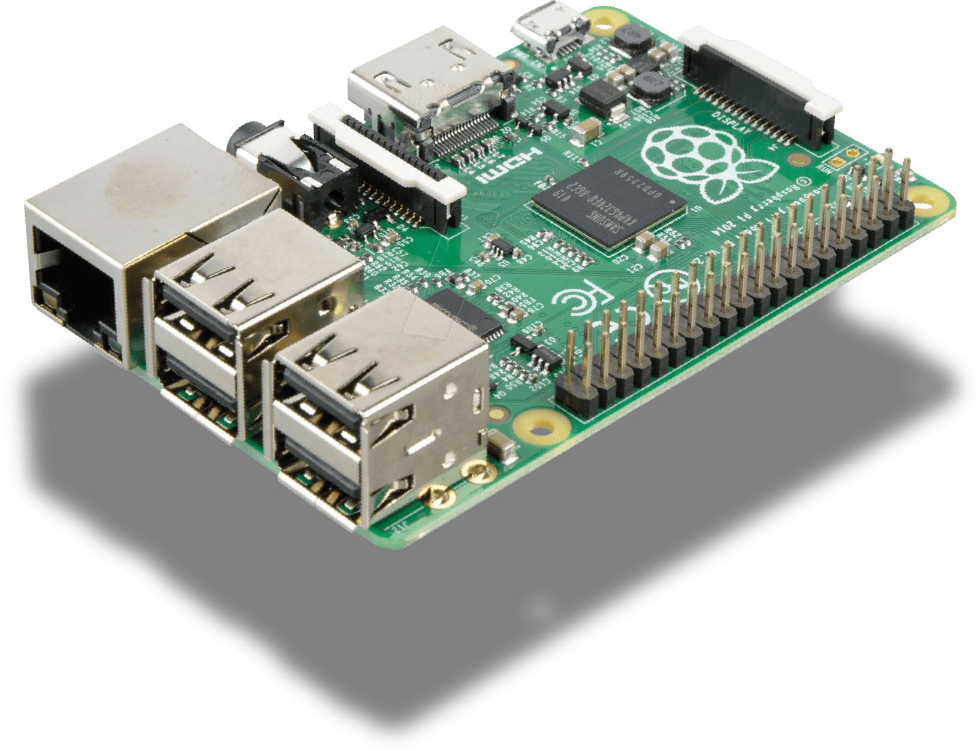
About the Raspberry Pi

Slide 3
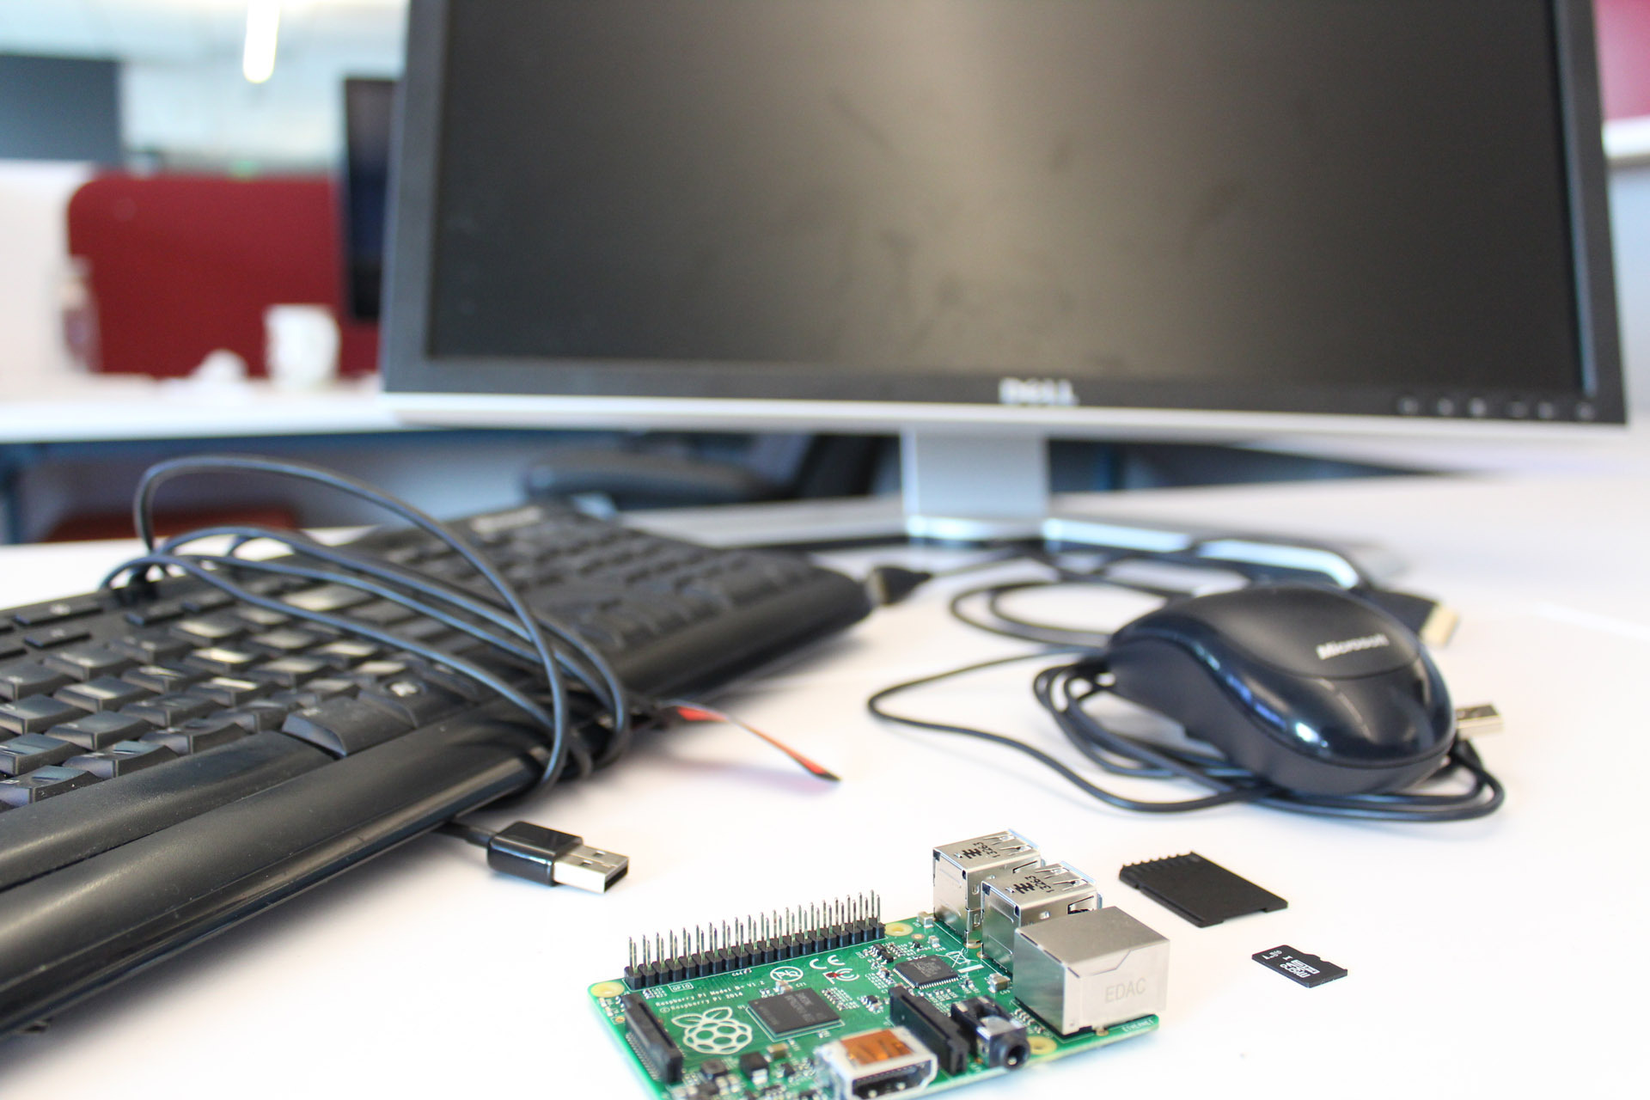
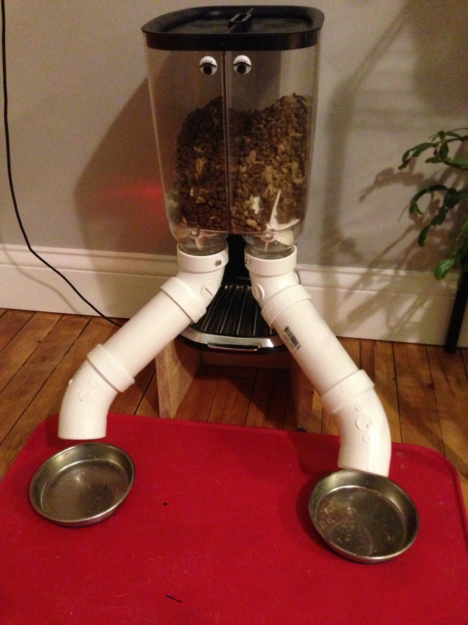
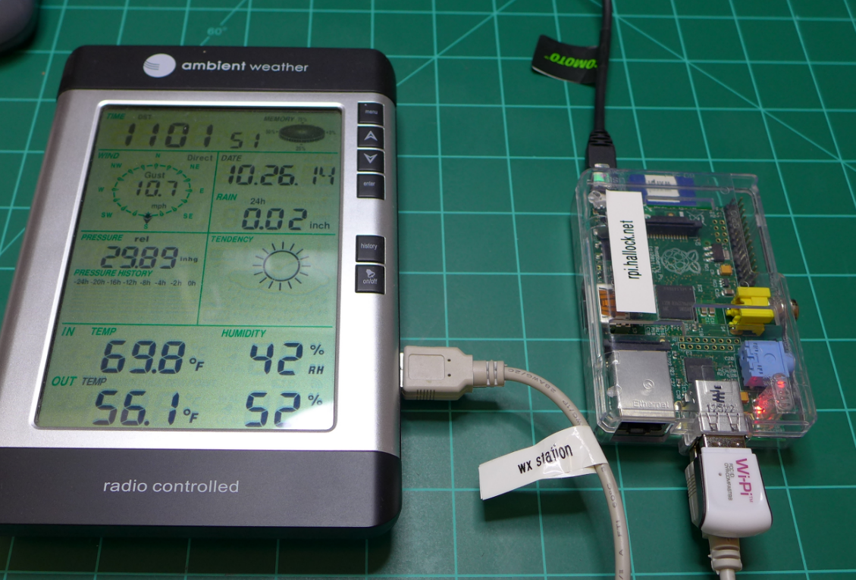
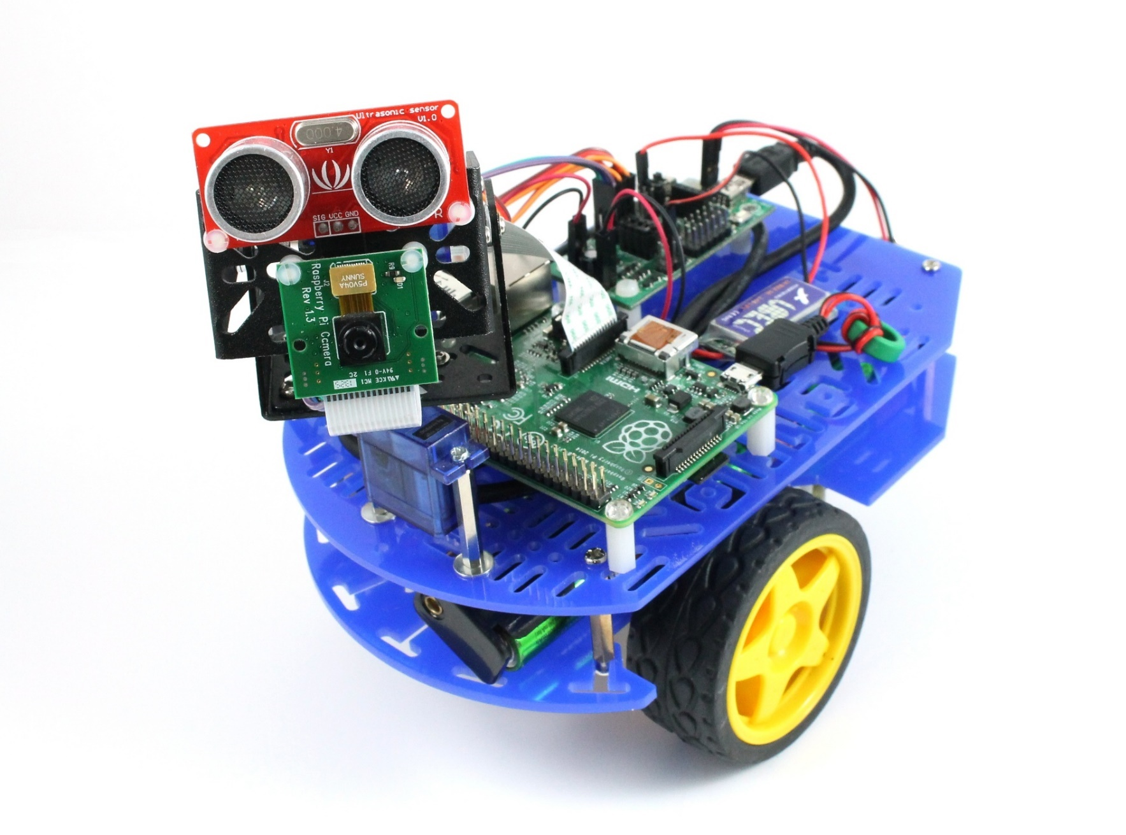
About the Raspberry Pi
Notes:
Talk about what the projects are.

Slide 4
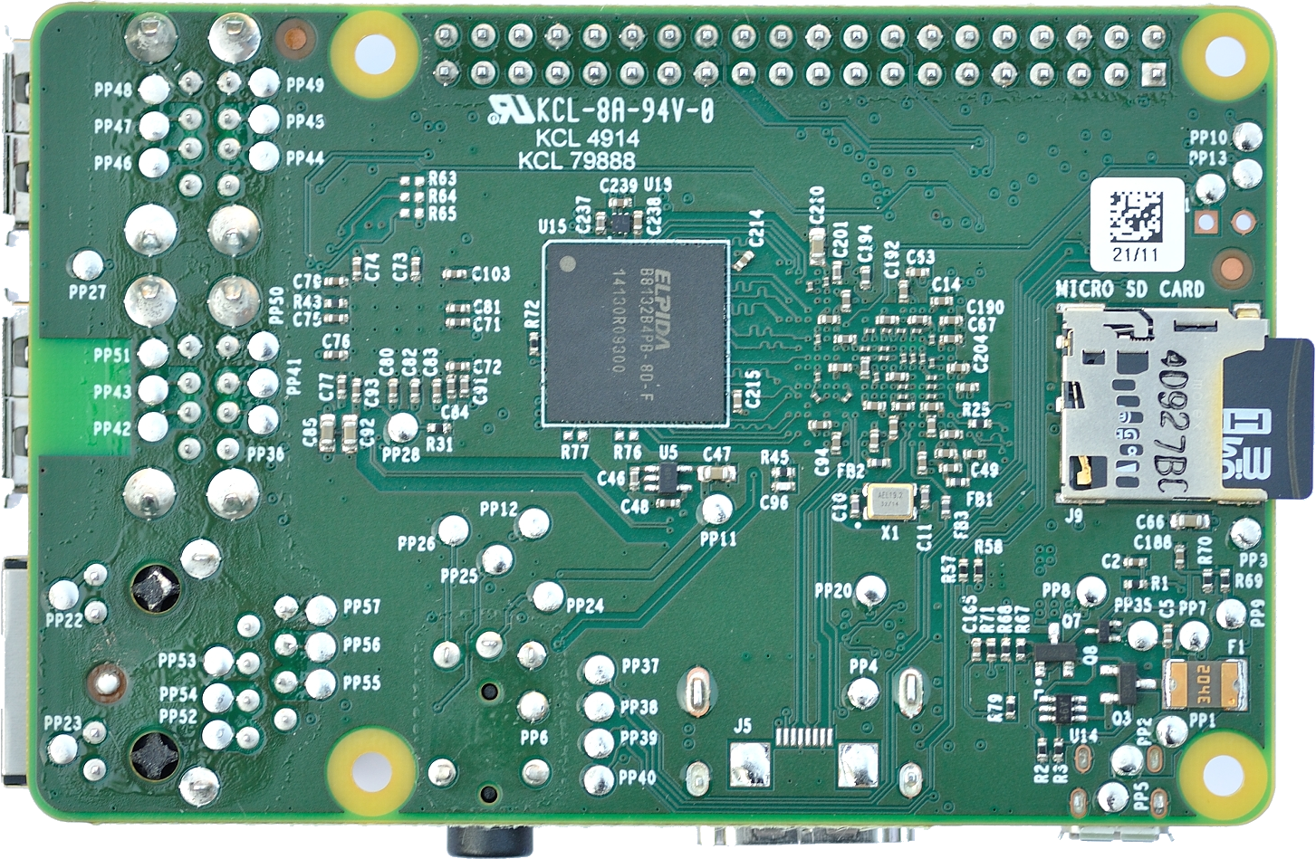
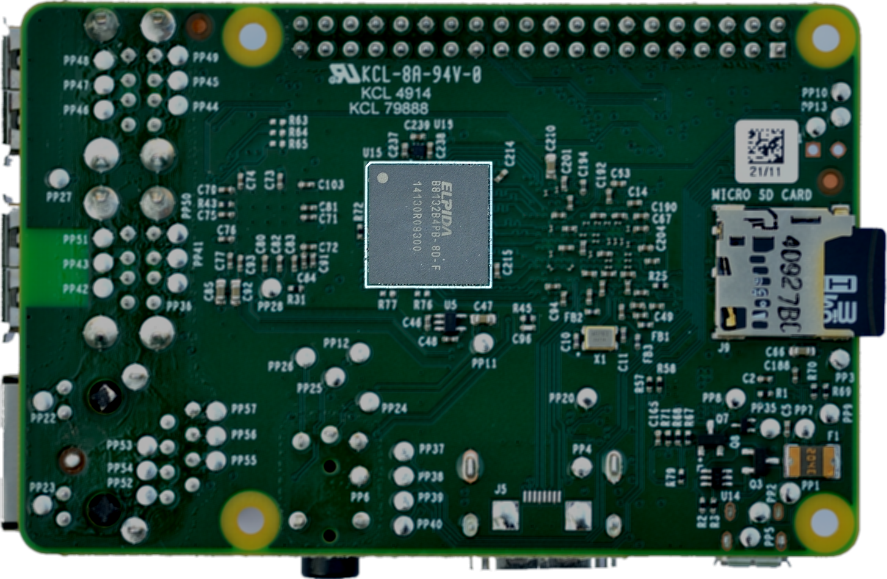
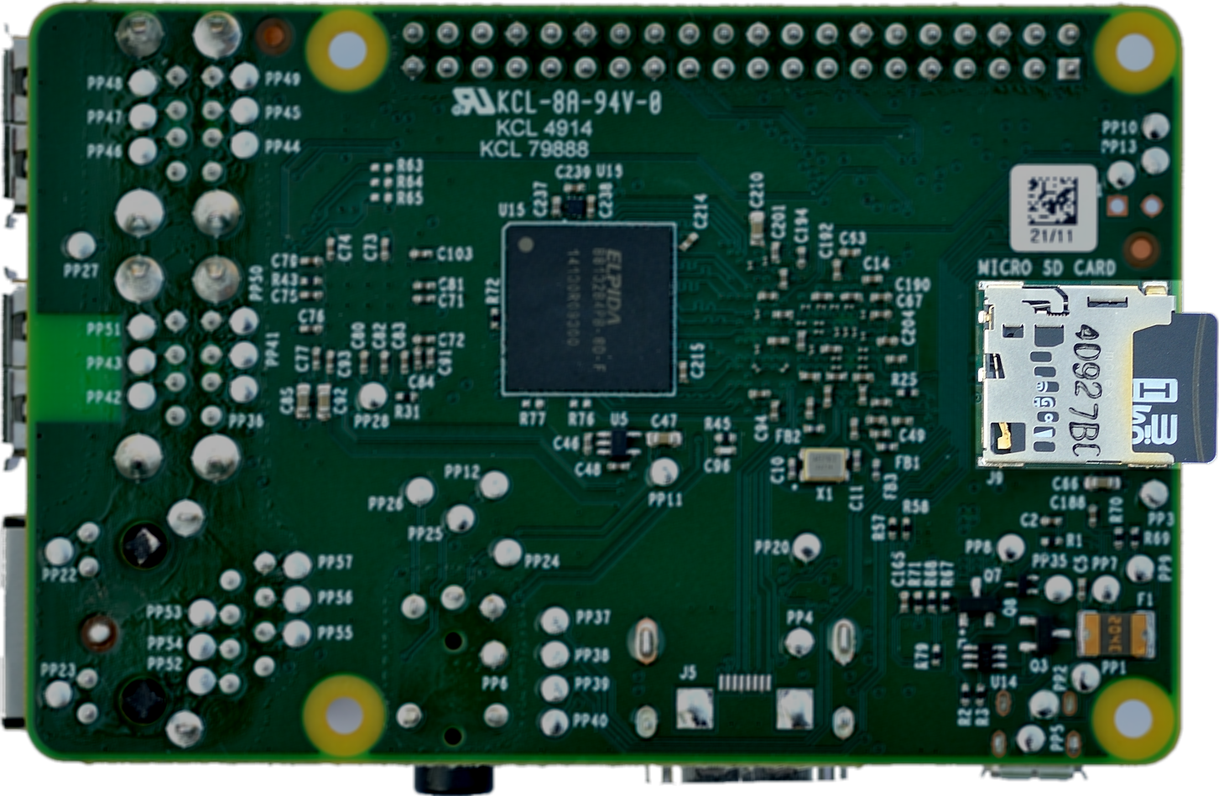
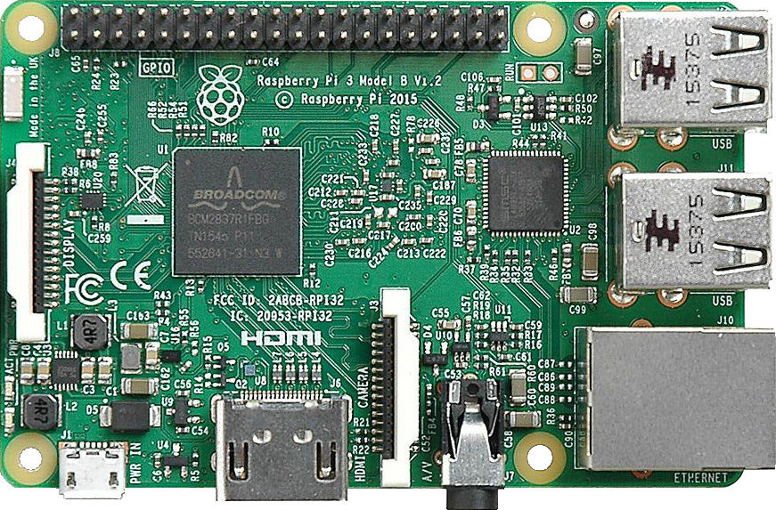
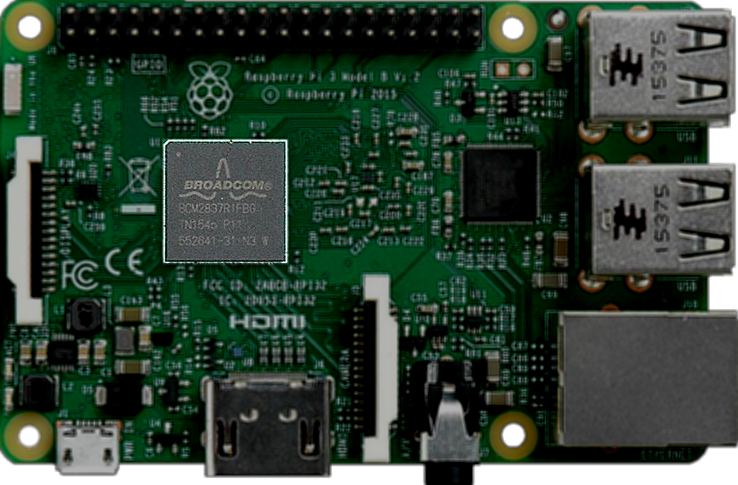
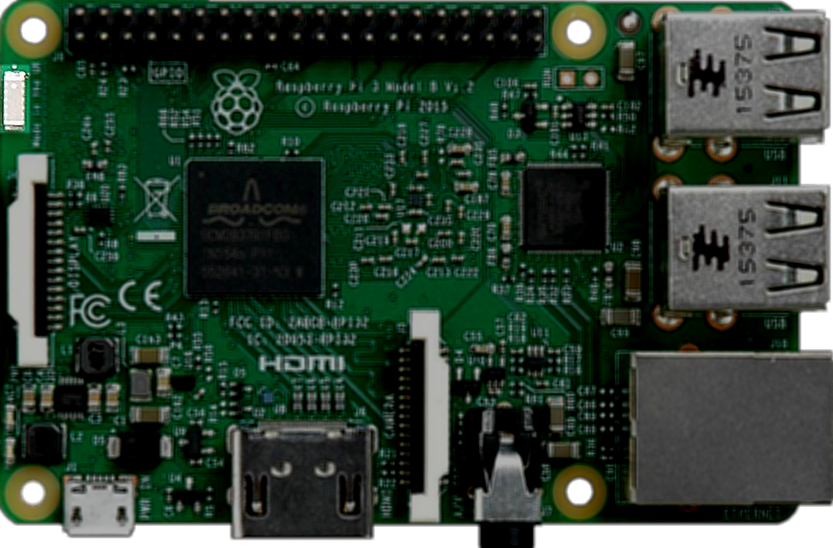
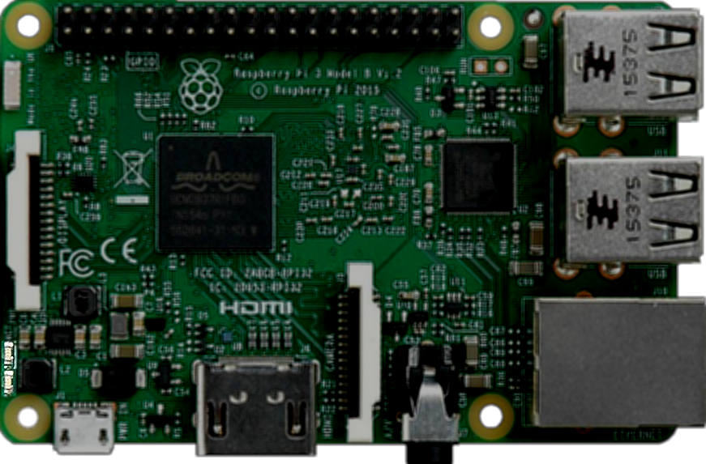
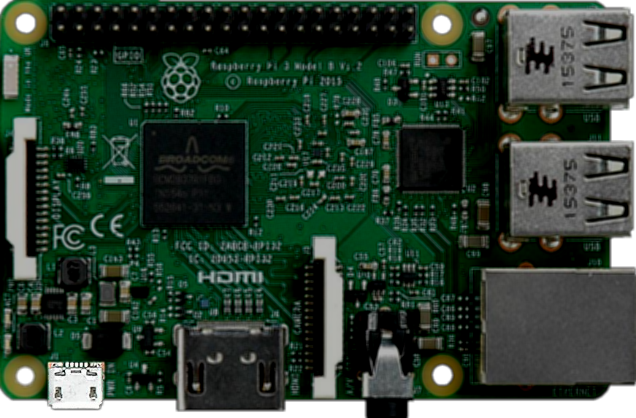
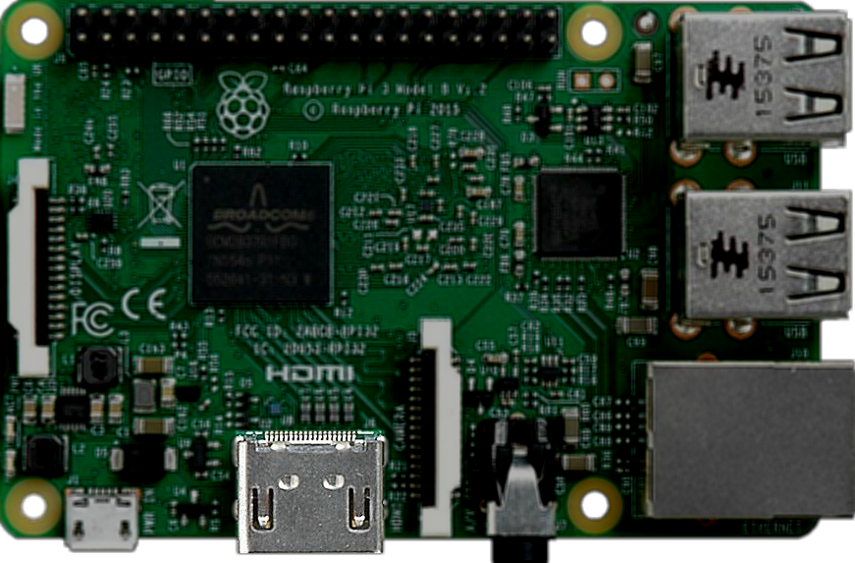
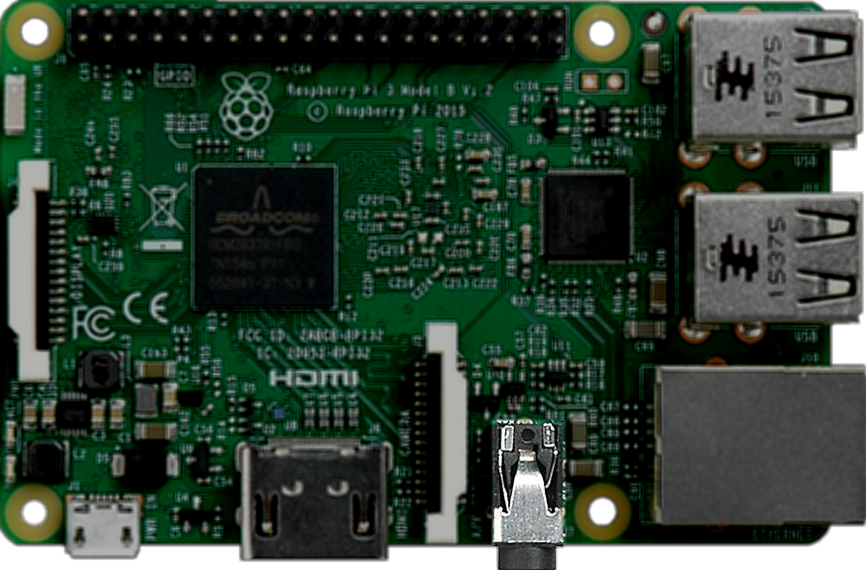
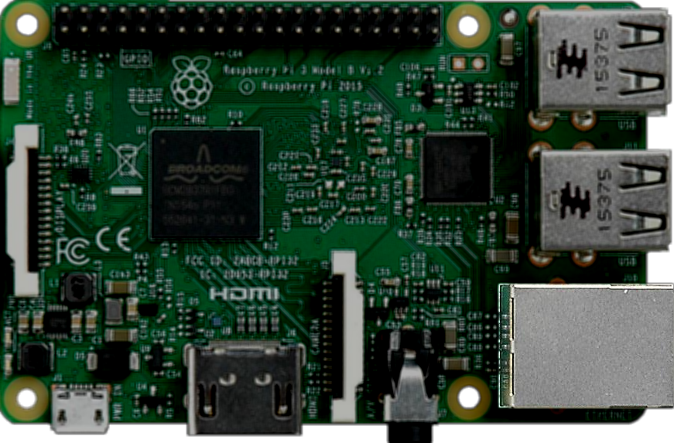
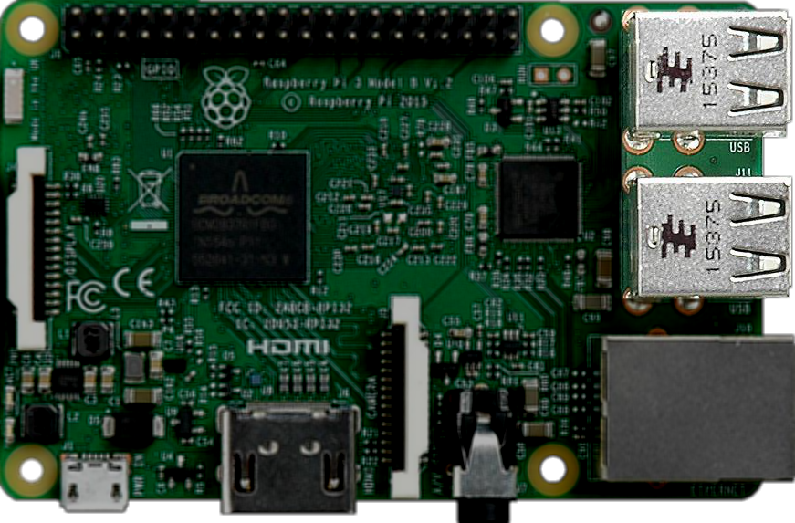
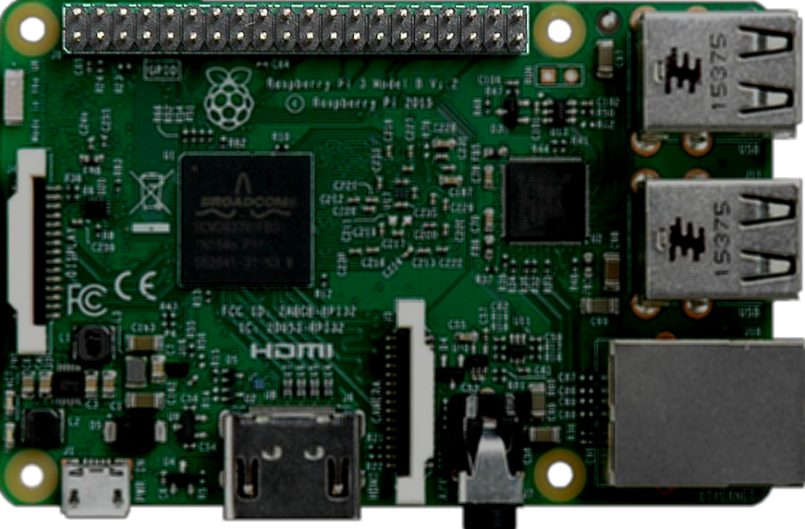
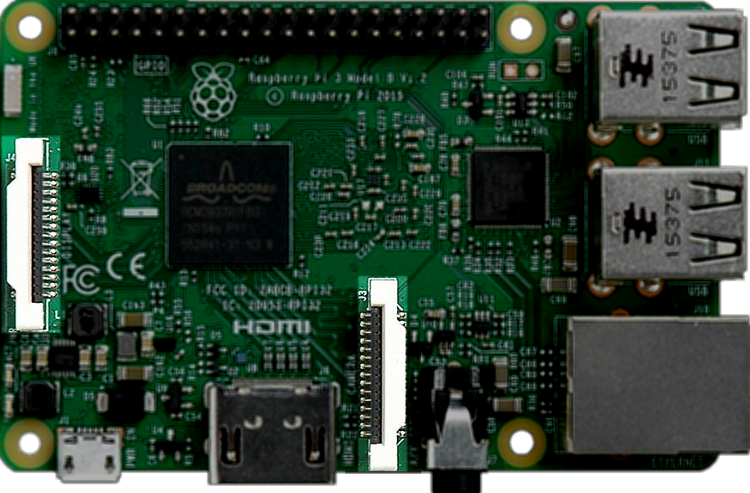
Tour of the Board
Notes:
Make more visible wasn’t that obvious.

Slide 5

Windows IoT Core

Slide 6
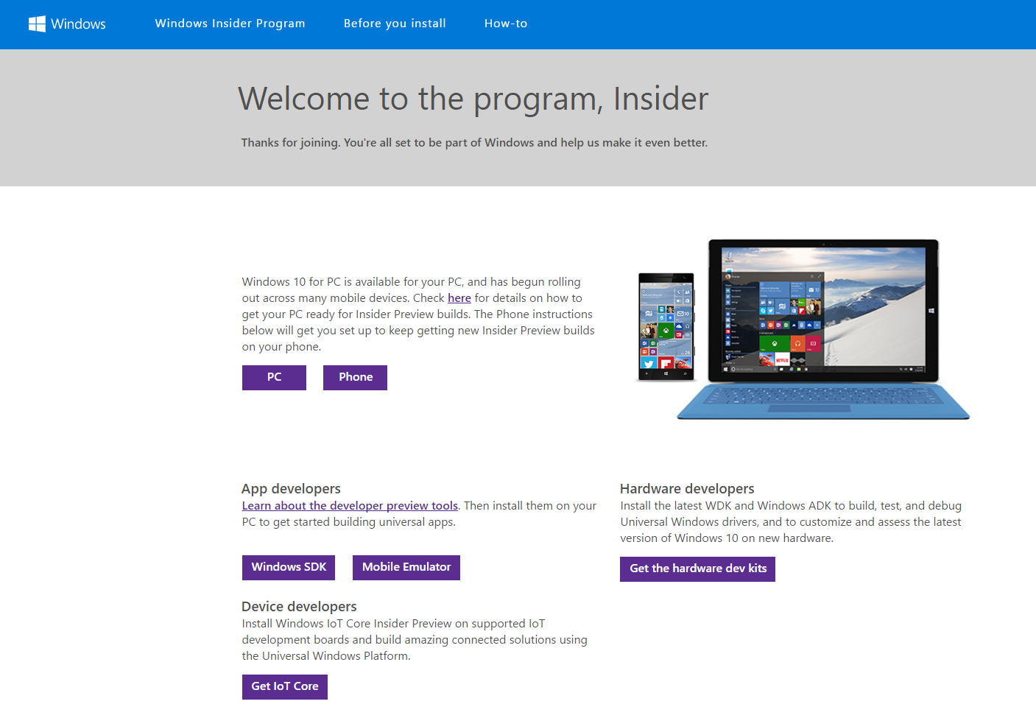
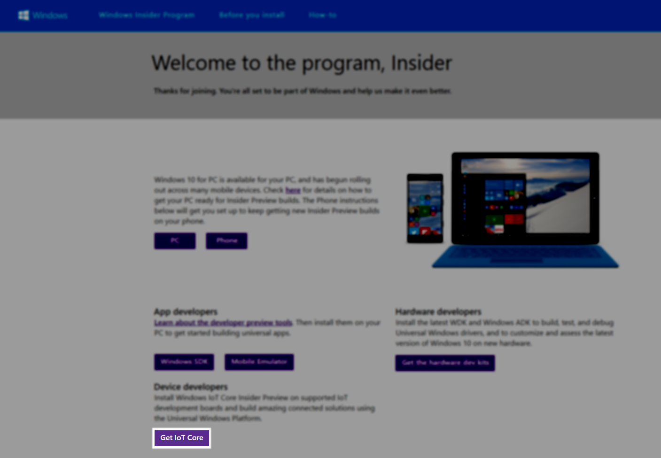
Windows IoT Core
Notes:
What is the insider program.
You don’t need a windows licence per RPi.

Slide 7

Notes:
Slow video down, don’t dim the video.

Slide 8
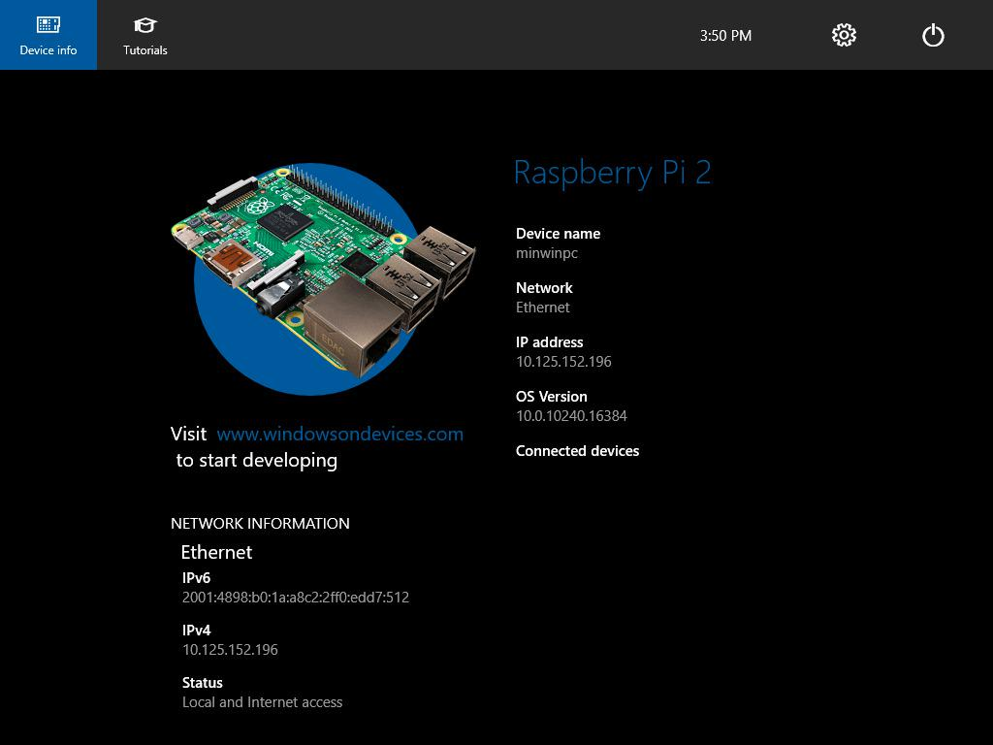
Connecting to the Raspberry Pi
Notes:
If I can switch to the actual desktop do so.
Add in another slide details the connection methods.
Talk about the sample apps on GitHub.

Slide 9
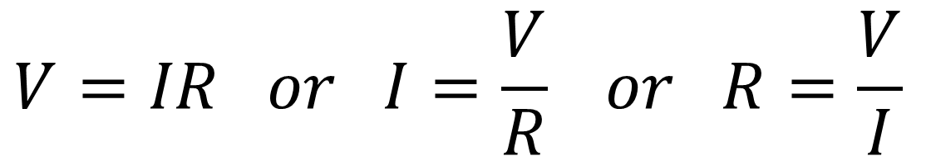
Electronics 101
Electrical Pressure – Voltage Volts (V)
Electrical Flow – Current
Amps (A)
Electrical Friction – Resistance
Ohms (Ω)
$$V=IR or I=\frac{V}{R} or R=\frac{V}{I}$$
Notes:
240v is 230v
Water as example high of res = PD width of pipe = res, liters / min = current (flow rate)
Image of sensor when talking about distance sensor.

Slide 10
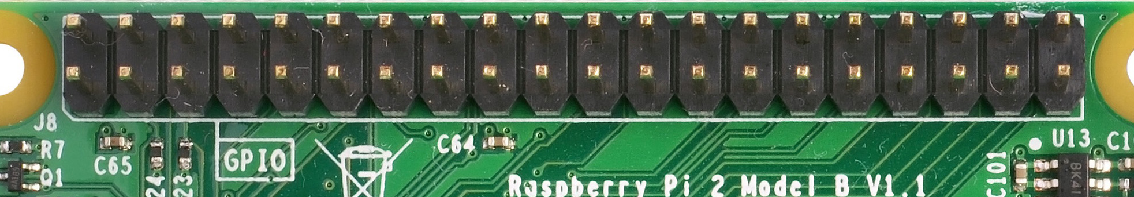
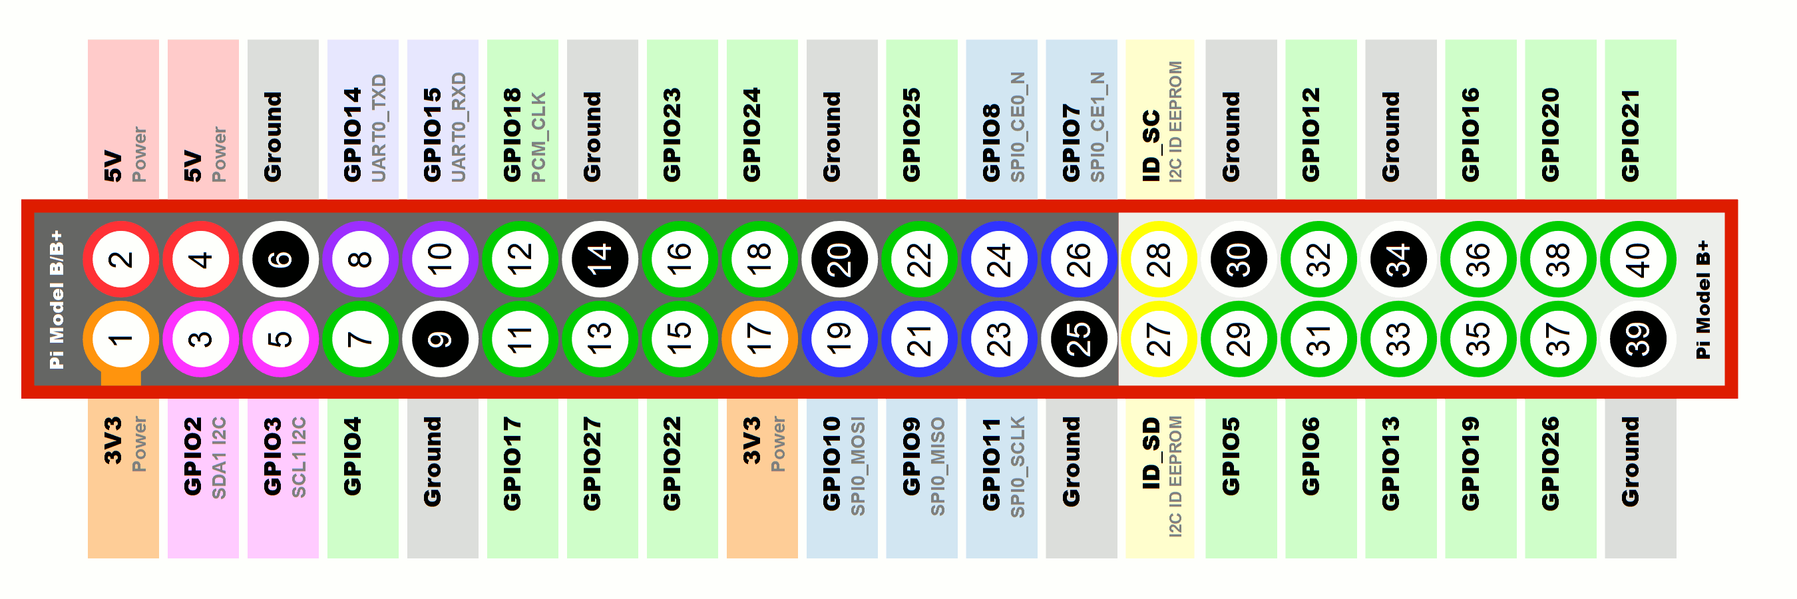
The GPIO Pins
Notes:
Explain that these pins can be configured to be an input to read sensors or an output to trigger components such as motors.

Slide 11
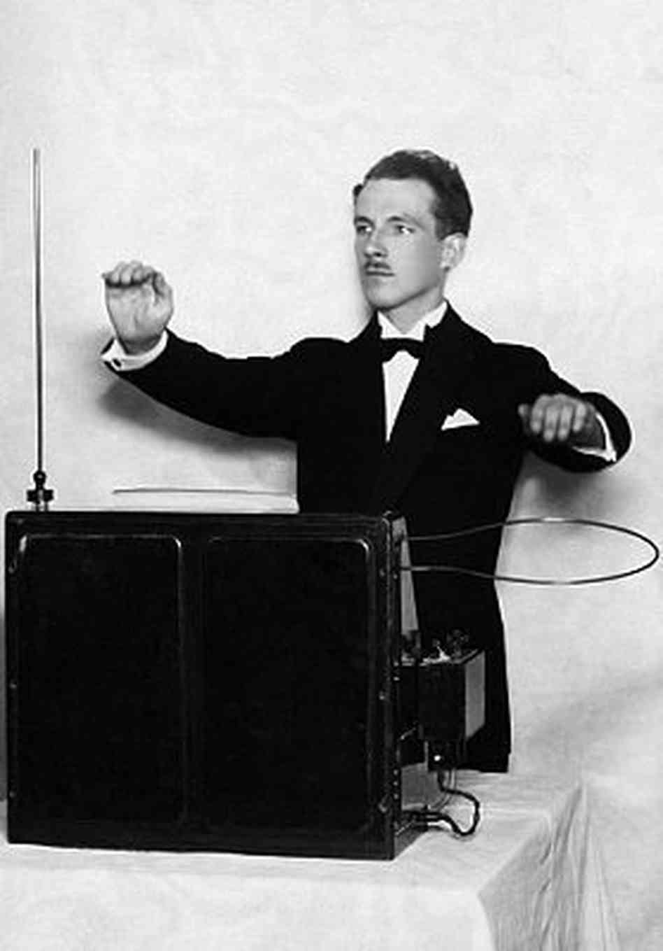
Theremin Pi

Slide 12
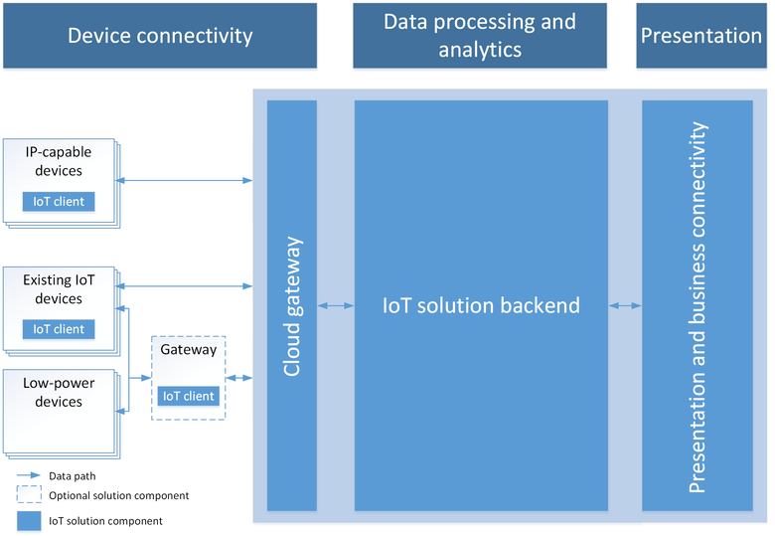
IoT Solution Architecture

Slide 13

Azure IoT Hub

Slide 14
Summary
Introduction to the Raspberry Pi
Installed Windows 10
Connected to and deployed a simple app
GPIO pins and electronics 101
IoT Solution Architecture
Azure IoT Hub

